Slide 1

Exploratory Data Analysis
BANK MARKETING - CAMPAIGN
14-June-2022

Slide 2
Background and Agenda
ABC Bank wants to sell it's term deposit product to customers and before launching the product they want to develop a model which help them in understanding whether a particular customer will buy their product or not (based on customer's past interaction with bank or other Financial Institution).
The data is related with direct marketing campaigns of a Portuguese banking institution. The marketing campaigns were based on phone calls.Often, more than one contact to the same client was required, in order to access if the product (bank term deposit) would be ('yes') or not ('no') subscribed.
There are four datasets:
1) bank-additional-full.csv with all examples (41188) and 20 inputs, ordered by date (from May 2008 to November 2010), very close to the data analyzed in [Moro et al., 2014]
2) bank-additional.csv with 10% of the examples (4119), randomly selected from 1), and 20 inputs.
3) bank-full.csv with all examples and 17 inputs, ordered by date (older version of this dataset with less inputs).
4) bank.csv with 10% of the examples and 17 inputs, randomly selected from 3 (older version of this dataset with less inputs).
The smallest datasets are provided to test more computationally demanding machine learning algorithms (e.g., SVM).
The classification goal is to predict if the client will subscribe (yes/no) a term deposit (variable y).

Slide 3
Data Exploration
1) Bank-additional-full.csv with all examples (41188) and 20 inputs, ordered by date (from May 2008 to November 2010), very close to the data analyzed in [Moro et al., 2014]
2) Bank-additional.csv with 10% of the examples (4119), randomly selected from 1, and 20 inputs.
3) Bank-full.csv with all examples and 17 inputs, ordered by date (older version of this dataset with less inputs).
4) Bank.csv with 10% of the examples and 17 inputs, randomly selected from 3 (older version of this dataset with less inputs).
Bank.csv
Bank-Full.csv
Bank-adiitional.csv
Bank-additinal-Full.csv
Final Bank Date
The Bank Data contained four(4) files, namely; Bank, Bank-Full, Bank-additional and the Bank-additional-full documents and all were in the >.csv format.

Slide 4
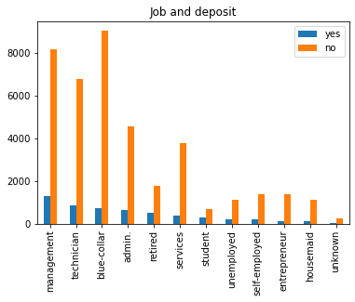
ANALYSIS OF JOBS AND IMPACT ON DEPOSITS
JOBS AND DEPOSITS ANALYSIS

Slide 5
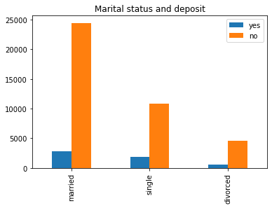
ANALYSIS
OF MARITAL STATUS AND IMPACT ON DEPOSITS
MARITAL STATUS AND DEPOSITS ANALYSIS

Slide 6
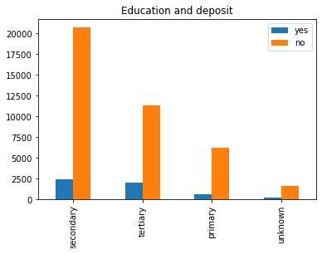
ANALYSIS
OF EDUCATION AND IMPACT ON DEPOSITS
EDUCATION AND DEPOSITS ANALYSIS

Slide 7
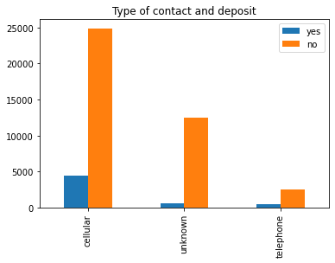
ANALYSIS OF THE METHOD OF CONTACT WITH CUSTOMER AND IMPACT ON DEPOSITS
METHOD OF CONTACT AND DEPOSITS ANALYSIS

Slide 8
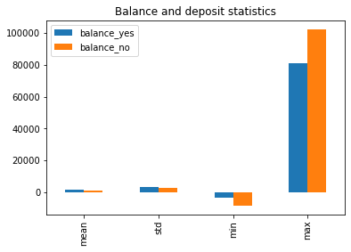
ANALYSIS
OF CUSTOMER’S BANK BALANCE AND IMPACT ON DEPOSITS
BANK BALANCE AND DEPOSITS ANALYSIS

Slide 9
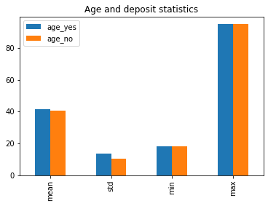
ANALYSIS OF CUSTOMER’S AGE AND IMPACT ON DEPOSITS
CUSTOMER’S AGE AND DEPOSITS ANALYSIS

Slide 10
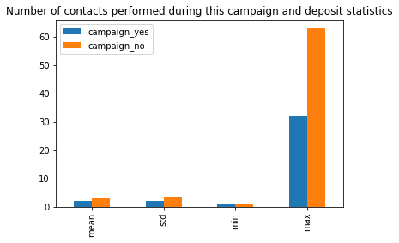
ANALYSIS
OF THE NUMBER OF TIMES BANK CONTACTED CUSTOMER AND IMPACT ON DEPOSITS
NUMBER OF CONTACT AND DEPOSITS ANALYSIS

Slide 11
FINAL RECOMMENDATI-ON AND FINDINGS
From Analysis we can tell according to our dataset:
1. Customers with 'blue-collar' and 'services' jobs are less likely to subscribe for term deposit.
2. Married customers are less likely to subscribe for term deposit.
3. Customers with 'cellular' type of contact are less likely to subscribe for term deposit.
4. People who subscribed for term deposit tend to have greater balance and age values.
5. People who subscribed for term deposit tend to have fewer number of contacts during this campaign.

Slide 12
PROPOSED MODELLING TECHNIQUE
THE TEAM IS GOING TO TEST OF THE FOLLOWING MODELS AND PICK WHICH HAS THE BEST ACCURACY SCORE;
LOGISTIC REGRESSION
RANDOM FOREST CLASSIFIER
SUPPORT VECTOR CLASSIFIER (SVC)
DECISION TREE CLASSIFIER

